Slide 1


Support Vector Machine (SVM) Algorithm
SVM is a powerful supervised machine learning algorithm for classification and regression tasks. It finds the optimal hyperplane to separate data points into different classes. SVM maximizes the margin between classes for robust classification.

Slide 2
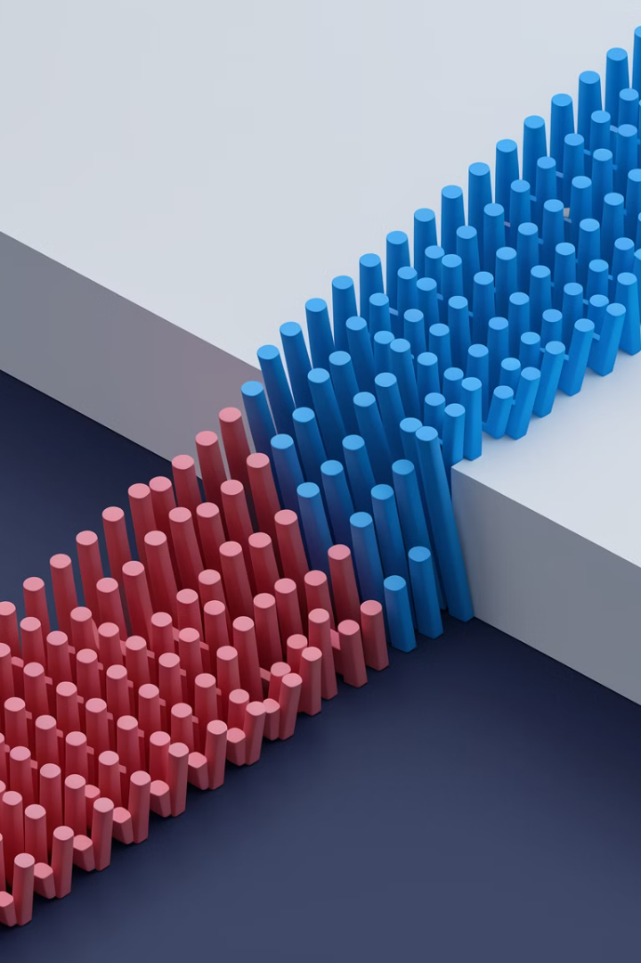
What is Support Vector Machine?
1
Classification Focus
2
Optimal Separation
SVM excels at classification tasks despite handling regression problems too.
Finds the best hyperplane in N-dimensional space to separate data points.
3
Maximum Margin
Maximizes the distance between nearest points of different classes.

Slide 3
SVM Key Terminology
Hyperplane
Support Vectors
Margin
Decision boundary separating classes in feature space. Represented by wx + b = 0.
The closest data points to the hyperplane. Crucial for determining the margin.
Distance between hyperplane and support vectors. SVM aims to maximize this.

Slide 4
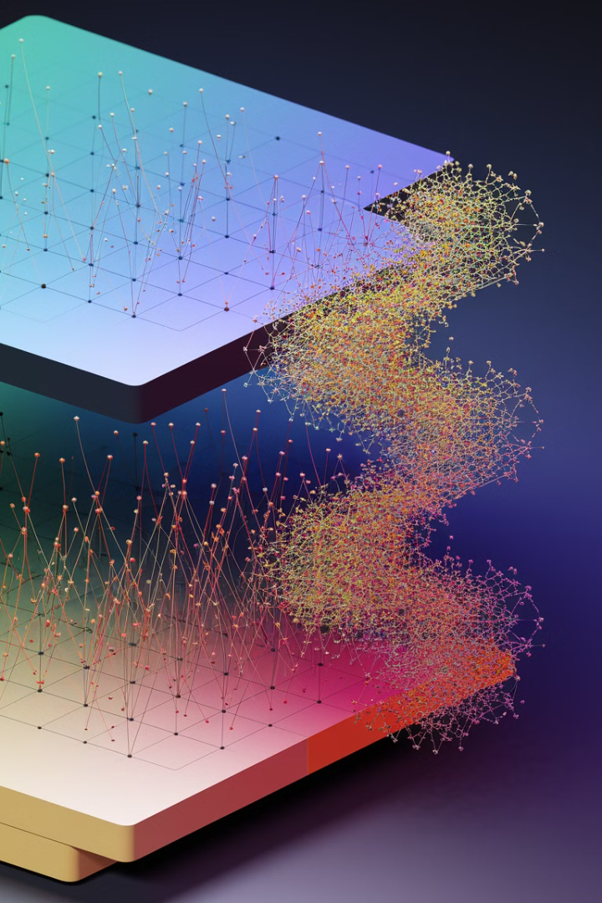
More SVM Terminology
Kernel
Hard Margin
Function mapping data to higher dimensions. Enables handling non-linearly separable data.
Maximum-margin hyperplane perfectly separating data without misclassifications.
Soft Margin
Allows some misclassifications by introducing slack variables. Balances margin maximization and penalties.

Slide 5
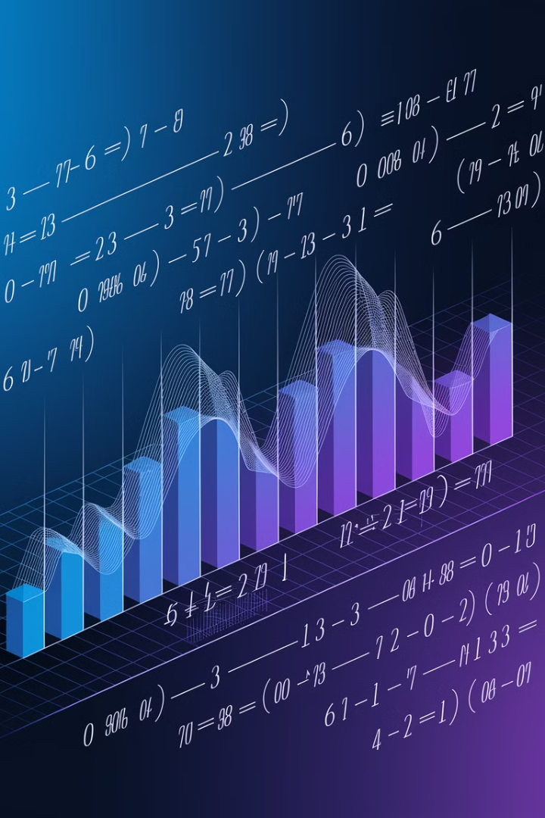



Final SVM Terminology
C Parameter
Hinge Loss
Dual Problem
Regularization term balancing margin maximization and misclassification penalties.
Loss function penalizing misclassified points or margin violations.
Involves solving for Lagrange multipliers associated with support vectors.

Slide 6

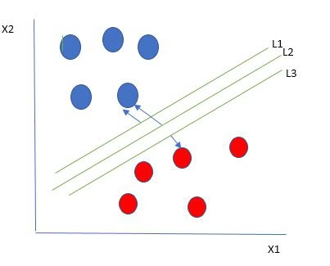
How SVM Works
Find Hyperplanes
Multiple hyperplanes can separate data from two classes.
Maximize Margin
Choose the hyperplane that maximizes distance to nearest data points.
Identify Support Vectors
The closest data points to the hyperplane become support vectors.

Slide 7
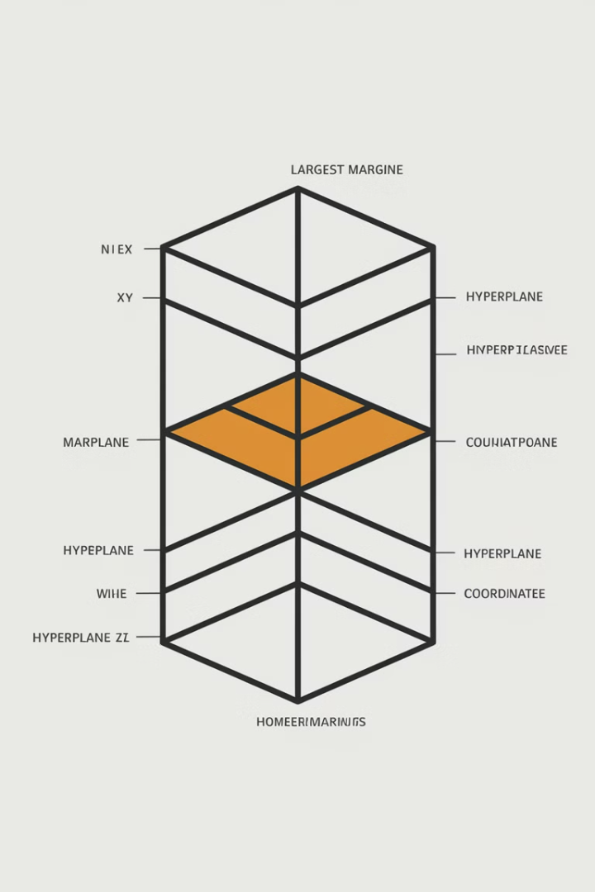
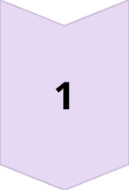
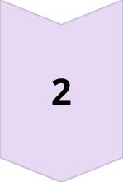
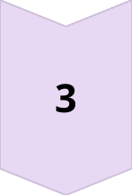
Best Hyperplane Selection
Multiple Options
Many possible hyperplanes can separate the data.
Hard Margin
Choose hyperplane that maximizes distance to nearest points.
Clear Separation
Ensures optimal boundary between classes for better generalization.

Slide 8
SVM and Outliers
Outlier Present
1
A blue data point appears in the boundary of red points.
2
SVM Processing
SVM algorithm identifies the outlier and adjusts accordingly.
Optimal Solution
3
SVM finds the best hyperplane despite the outlier.

Slide 9
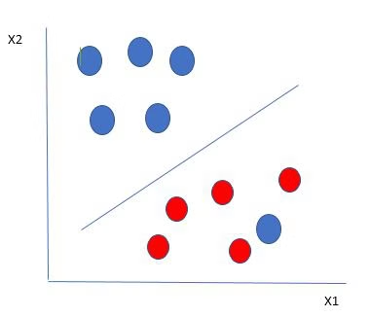
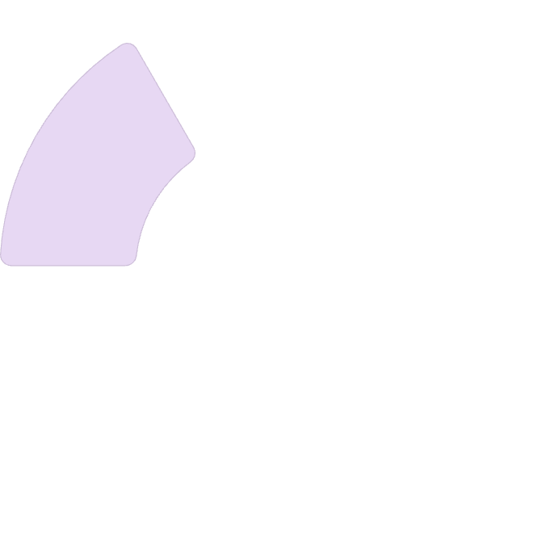
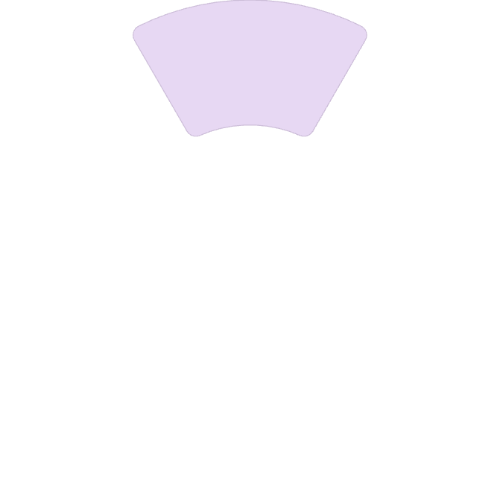
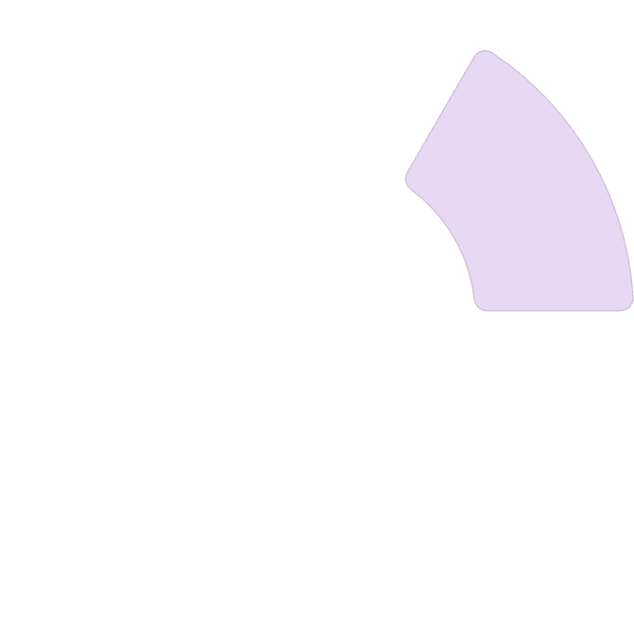
SVM Outlier Handling
SVM shows remarkable robustness to outliers in classification tasks. It can identify and effectively ignore outliers when finding the optimal hyperplane.
Margin Optimization
Focus on maximizing margin despite outliers.
Outlier Detection
Robust Classification
SVM identifies unusual points in the dataset.
Results in more reliable classification boundaries.
2
1
3

Slide 10
Soft Margin SVM
1
C
0
Misclassification Tolerance
Regularization Parameter
Hinge Loss
Controls trade-off between margin and violation penalties.
No penalty for correctly classified points within margin.
Allows some points to violate the margin for better generalization.

Slide 11
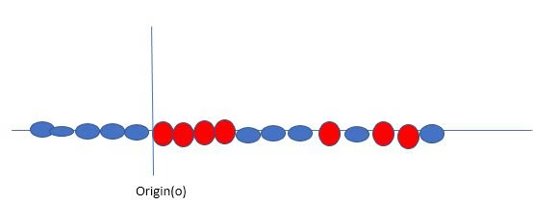
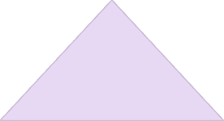
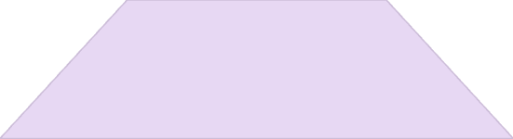
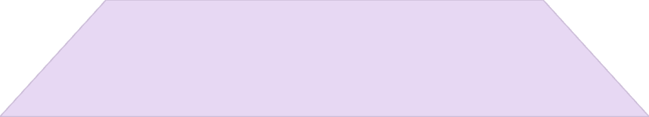
Non-Linear Classification
When data isn't linearly separable, SVM needs a different approach. Traditional linear boundaries can't separate these data points effectively.
Kernel Transformation
1
Map data to higher dimensions
Feature Space
2
Work in transformed space
Original Data
3
Non-linearly separable points

Slide 12
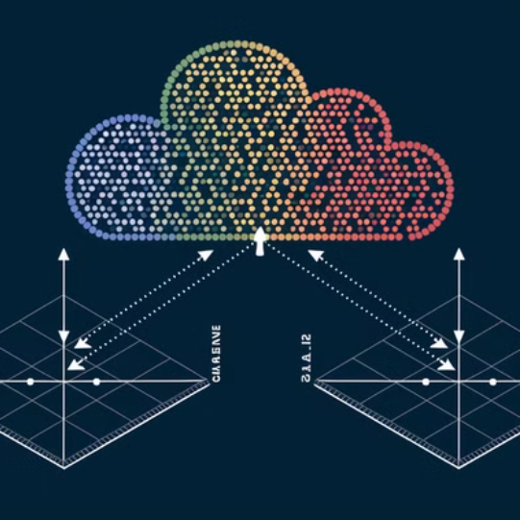
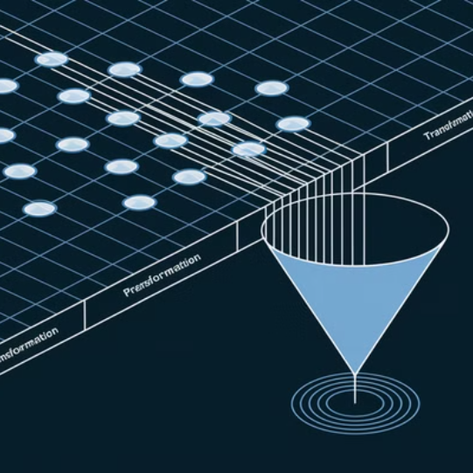
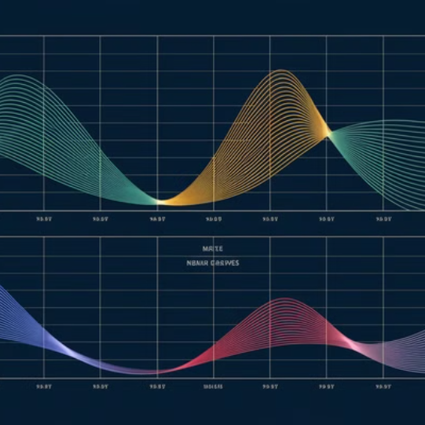
The Kernel Trick
Linear Kernel
Polynomial Kernel
RBF Kernel
Suitable for linearly separable data. Simplest kernel form.
Maps data into polynomial feature space. Good for curved boundaries.
Transforms data based on distances between points. Highly flexible.

Slide 13
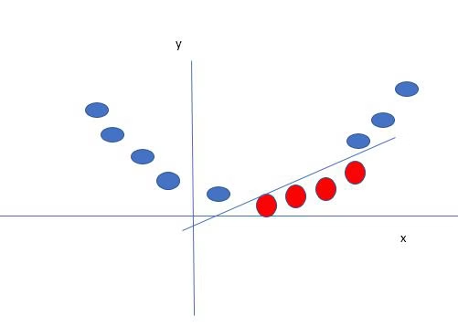
Dimension Transformation
Higher Dimension
1
Classes become linearly separable
Transformation
2
Apply kernel function
Original Data
3
Non-linearly separable

Slide 14
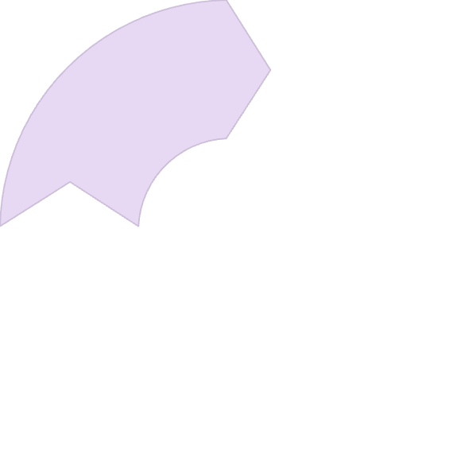
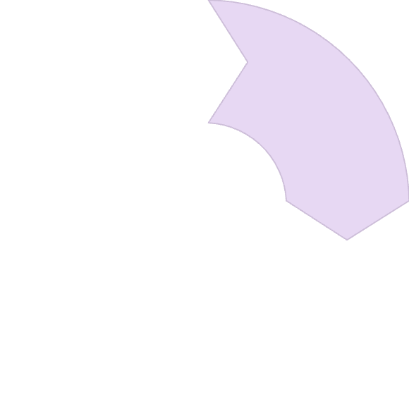
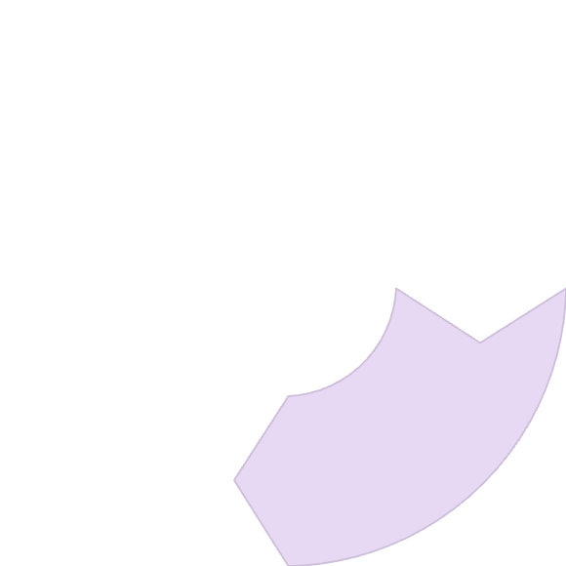
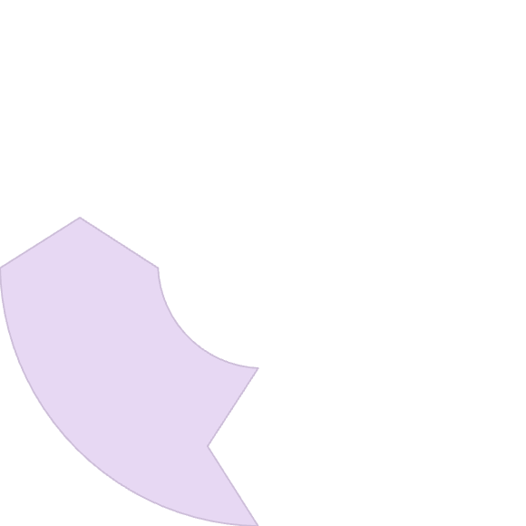
SVM Mathematical Foundation
Hyperplane Equation
Distance Calculation
1
wᵀx + b = 0
2
d = (wᵀx + b)/||w||
Optimization Problem
Classification Rule
4
3
Minimize ||w||² subject to constraints
y = 1 if wᵀx + b ≥ 0, else 0

Slide 15
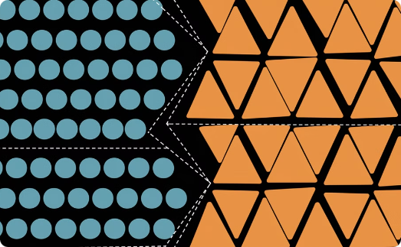
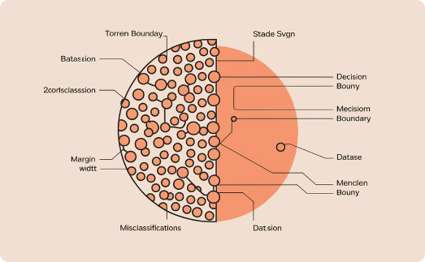
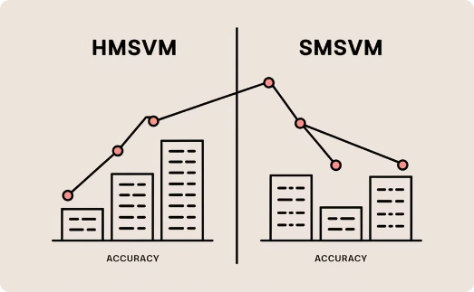
Hard vs. Soft Margin SVM
Hard Margin SVM
Soft Margin SVM
Practical Application
Perfect separation of classes. No misclassifications allowed. Works only with linearly separable data.
Allows some misclassifications. Uses slack variables ζᵢ. Controlled by parameter C.
Soft margin is more practical for real-world noisy data. Prevents overfitting to outliers.

Slide 16
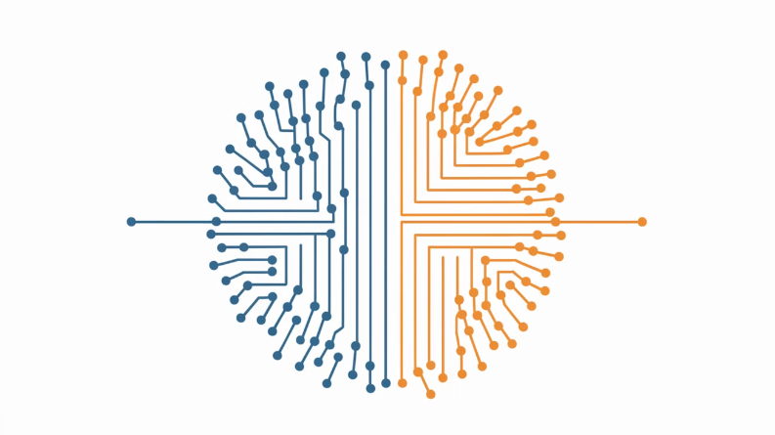
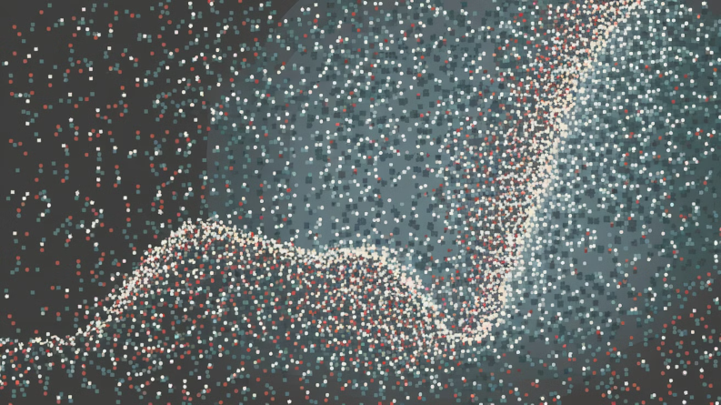
SVM Types
Linear SVM
Non-Linear SVM
Uses linear decision boundary. Suitable for linearly separable data. Simple hyperplane separates classes.
Uses kernel functions. Transforms data to higher dimensions. Finds non-linear decision boundaries.

Slide 17
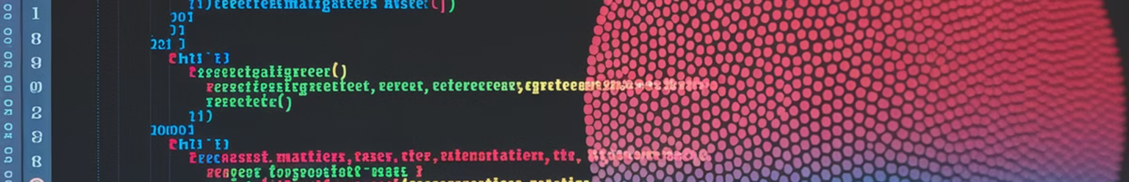
Python Implementation
from sklearn.datasets import load_breast_cancer import matplotlib.pyplot as plt from sklearn.inspection import DecisionBoundaryDisplay from sklearn.svm import SVC cancer = load_breast_cancer() X = cancer.data[:, :2] y = cancer.target svm = SVC(kernel="rbf", gamma=0.5, C=1.0) svm.fit(X, y)

Slide 18

Breast Cancer Classification Results
Dataset
Breast Cancer Wisconsin
Features Used
First two features only
Model
SVM with RBF kernel
Parameters
gamma=0.5, C=1.0
Visualization
Decision boundary with scatter plot

Slide 19
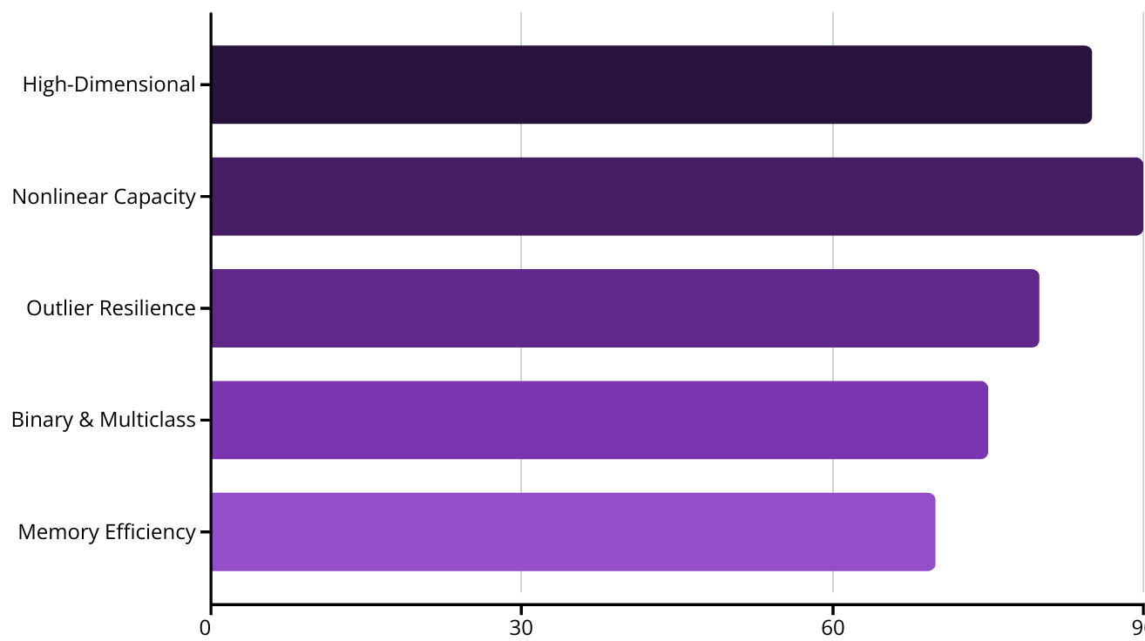
Advantages of SVM
SVM excels in high-dimensional spaces like image classification. It handles nonlinear relationships with kernels and resists outliers with soft margins. Works for both binary and multiclass problems.

Slide 20

Disadvantages of SVM
1
2
Slow Training
Parameter Tuning
SVM can be slow for large datasets. Impacts performance in data mining tasks.
Selecting the right kernel and C parameter requires careful tuning.
3
4
Interpretability
Scaling Sensitivity
Complex hyperplanes in higher dimensions make SVM less interpretable.
Proper feature scaling is essential for good performance.

